Slide 1
Welcome
IFPMC Committee Webcast Meeting
June 22, 2017

Slide 2
Today’s Agenda
Welcome and Introductions
- Intermodal Committee Chairs: Laurie Carlson - MassDOT,
Thomas McQueen - GDOT, David Rosenberg - NYSDOT
Intermodal Committee Activities and Project Updates
- Marygrace Parker, I-95 CC, Freight Program Director
Highlights from I-95 CC State Freight Planning Interviews
Freight Data Matrix
Freight Academy 2017
I-95 Real Time Truck Parking Project
Agency Spotlight Presentation: "Philly Freight Finder"
Michael Ruane, Transportation Planner,
Delaware Valley Regional Planning Commission
Intermodal Committee 2017/2018 Focus Areas
- Co-Chairs, Group
Focus areas: suggested topics, discussion

Slide 3
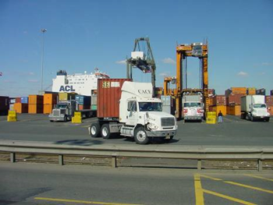
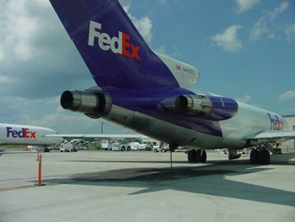
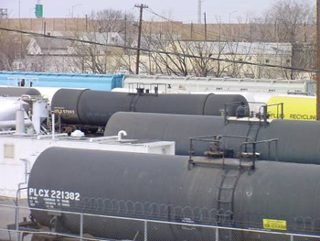
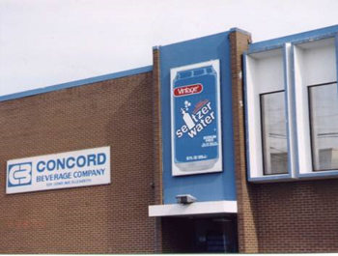
Intermodal Freight Committee
Focus: promote reliable, efficient, and balanced intermodal transportation throughout the Coalition states by supporting leadership, information technology, and operations that improve the intermodal movement of freight.
Co-Chairs:
David Rosenberg, NYSDOT
Thomas McQueen, GDOT
Laurie Carlson; Mass DOT

Slide 4
Highlights – State Freight Planning Interviews

Slide 5
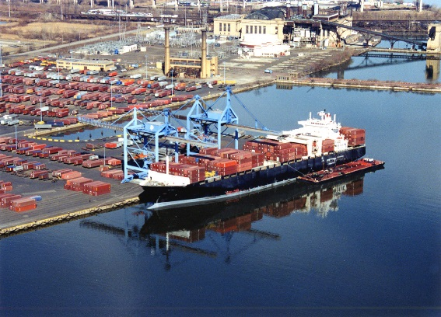
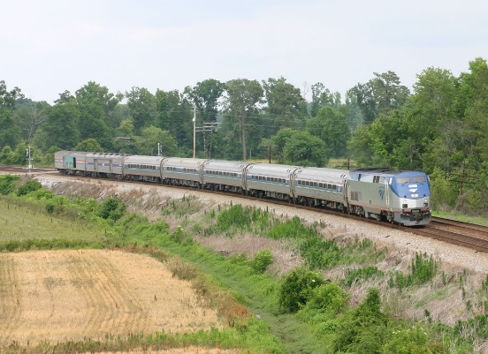
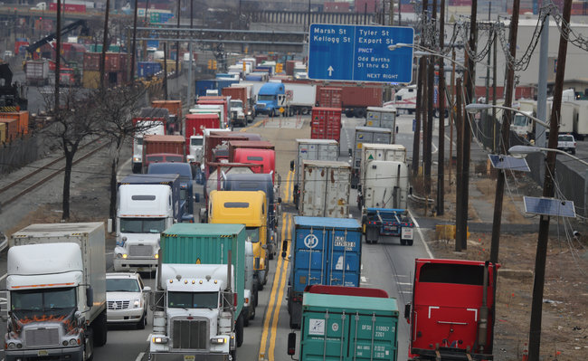
State Freight Plans Interviews
Objective:
Gather and share issues/challenges/ experiences from members in freight planning including efforts developing FAST Act compliant State Freight Plans.
Provide initial feedback (this webinar!)
Develop document summarizing information collected and share with agencies
Utilize information to help inform focus of - and member support by - this committee
Status:
13 state interview conducted, four pending - to be completed July 2017
Summary report to follow

Slide 6
State Freight Planning Interviews Format/Content
Interview guide developed with series of questions related to both State Freight Plan (FAST ACT) development and gaining insight to overall freight planning by states
Phone interviews conducted by Coalition staff
State Freight Plan questions included:
status, emphasis areas, process, stakeholder input, performance measures, challenges in development, innovative approaches taken
Freight Data
What data sources were used for FAST Act Freight Plan development and for general agency freight planning, data challenges, unmet needs, “Wish list for data”….

Slide 7
State Freight Plan Status
All agencies interviewed have plans in process with intended submission dates ranging between July and Dec except:
One agency will submit in 2018
One agency has an FHWA approved FAST Act plan – Congratulations Vermont!
5 Agencies started with MAP 21 Compliant Plans
5 agencies had some form of existing Freight Plan to update/build from
3 agencies were undertaking first ever full freight plan*
* Had rail plans

Slide 8
State Freight Plans Purpose and Emphasis Areas
Beyond federal compliance and eligibility for grants; plan purpose:
Making case for investments
Establish baselines for prioritizing investment
Have Performance Measures /strategies for freight/trade corridors performance
Audience
Public Officials – state/local/legislative
External stakeholders
General public
Emphasis areas included:
Economic development/growth
SOGR, Asset Management
Resiliency
International border crossings (efficiency, connectors…)
Land use, sustainability, brownfield redevelopment
Safety
Strategic initiatives to support freight (i.e. workforce development)

Slide 9
Stakeholder Input
Freight Advisory Committees (FAC)
Majority of agencies established FAC (several started during MAP 21; MD had long-standing group)
Several specifically chose to not create a FAC but use an existing stakeholder group
Identifying members varied from “appointments”, to agencies examining economic data for key industries
Multi-modal heavily focused on industry sectors, MPOs involved in some manner
No states are using FAC to “approve” plan
Moving meetings geographically were important to process and were critical to expand stakeholder input and understand varying needs/input (i.e. urban vs rural)

Slide 10
Stakeholder Input
Interviews, mailings, focus groups w/key industries
Use of social media valuable for outreach and input
Websites, newsletters, public notice of FACs meetings
i.e., agency used gov.delivery sign-up for push notifications
Use of summits
(i.e. Baltimore Metro Downtown Delivery Symposium; DelDOT semi-annual Freight Summits
States’ outreach to neighboring state(s) such as:
MassDOT made CT DOT member of FAC
SC/NC - SC role in Charlotte freight plan
DelMarVA states utilized on-going relationship

Slide 11
Freight Data Sources
FAF – used by majority but not all states
Transearch - used by some but not all states
Several cited cost, but not only factor, in decision
NPMRDS data used by most (with some ATRI “additional”)
Other sources:
Probe Data: INRIX; TomTom, Bluetooth/Wavetronics (DE)
STB Waybill data
FMCSA data
OS/OW agency permit data
US Army Corp of Engineers
Census
Industry Interviews (i.e., MA: Legal Seafood – intermodal data for port/truck)
Aviation (agencies with publicly owned facilities)
MPOs, RPOs, Economic Development Agencies, State Commerce, Labor and Training for Employment numbers/categories
“FAF to QAQC Transearch if different sample size/or saw something askew”
“Didn’t rely heavily on commodity or O&D, concern on over-focus on data”
Notes:
7 or 13 cited transearch

Slide 12
Data Analysis
Most used combination of in-house & consultants
Several agencies found “on-tapped” resources within other parts of agency for data and/or data analysis
Analysis sought to assess and/or identify:
Flow Data - directly relates to congestion/infrastructure condition for asset mgmt. Align Asset Mgmt with Perf Mgmt
Origin-destination – flows and trends
What is moving, by what mode, bottlenecks
Process to build into scoring plan for TIP projects
Areas of deficiencies
Merits of proposed CUFCs and CRFCs

Slide 13
In-House Data Tools
Not all states have in-house tools, some rely on 3rd party and/or using various tools to support freight analysis. Among them:
Cube Cargo Travel Demand Model (DE)
RITIS, ESRI (MDSHA)
ESRI, creating new tool for MPOs to import projects (MA)
TDM, Commodity Flow Tool, Commodity Information System (PA)
Tool developed from SHRP2 (RI/RI Statewide Planning)

Slide 14
Data Challenges
Challenges (besides cost $$$)
Reliability: Results don’t always match what we know anecdotally;
Quality/Transparency: Sometimes taking these on faith; even the “free stuff”
Limited staff with data analytics, requires more 3rd party
Different data formats – big challenges
Very time-consuming to align FAF and Transearch
No one system (such as RITIS) that includes all data
Procurement process, data agreements/limitations on use
Variable numbers between previous/existing versions of Transearch; data on pipelines has been difficult to obtain
Fact that we don’t have single source to use regionally/nationally due to lack of consistency in data/procurement

Slide 15
Unmet Needs / Data “Wish List”
How to extract data and apply in “user friendly” manner (tools, processes)
Timeliness of data (More timely updates of FAF would reduce need to go to Transearch, better disaggregation of FAF to county levels, more current snapshots to update algorithm)
Trying to look at “last mile” w/o data (Address different level of detail where commodities are on system)
More/easier alignment of FAF and Transearch (better alignment, address variables in each)
More ability to share data – single, consistent source (shared procurement)

Slide 16
Critical Urban/Critical Rural Freight Corridors
Among processes agencies used:
Economic generators/where gaps might be
Lane miles in each of MPOs, stressed linkage to PFN
Analysis tool provided some segments that were more inclusive, but also made case why some more strategic
Congestion and bottlenecks were primary criteria
First identified state PFN, overlaid projects from current STIP that had been thru prioritization process, CRFC identified and recommendations of CUFC made to MPOs
Did NOT identify CUFC or CRFC, didn’t see need.

Slide 17
A few Innovations to Share
Integrating all plans (Freight, Rail, Transit) as part of an integrated statewide management plan (SC DOT)
Multi-modal plan helped make case to legislature for transportation funding ; Plan under one umbrella, could marry resources (incl. FTA $)
Focused on biomass/biofuel productions such as wood pellets (for export) and ethanol (GDOT)
OS/OW data with Pavement and Bridge data and came up with damage and cost (NJDOT)
Commodity Flow and CIS, Freight tool (PA DOT)
Meat and Potatoes - don’t overlook SOGR as innovation (RISP)

Slide 18
Cost Saving Tips/ Suggestions for Coalition Support
Cost-saving Tips:
Interviews of industry – yielded much info and data
Use of Benefit Cost Analysis tool
Taking advantage of in-house data/resources and data sources not traditionally used for Freight Analysis
Areas for Coalition Support:
Examine feasibility for shared freight data procurement
Sharing of Information/Best Practices, Peer Exchanges
What are in other state plans, i.e. projects; where are gaps in data, policy “Share the best...and the worst”
Support regional/corridor planning, “watercooler” discussions, examine emerging issues w/Corridor view
i.e., connected/automated trucks, truck parking

Slide 19
Next Steps
Finish Interviews with remaining agencies
Circle back to fill any gaps if necessary
Performance Measures and Project Prioritization were still in flux for a number of agencies
Develop summary report

Slide 20
Freight Data Matrix

Slide 21
Freight Data Matrix
Objective:
Enhance understanding of the current freight data state of the practice
Approach:
Develop a “freight data matrix” that shows:
Sources of available data, and several key items (public vs. private data, static data vs. passive data, key “tips” for analyzing each source, etc.)
Build on information gleaned from freight data interviews with Coalition members and related data discussions nationally
Output:
A matrix “reference table” for agency staff on data
Develop recommendations (and associated benefits) to assist the Coalition and its members in outlining what initial steps need to be taken for expanding access to, and usability of, freight data

Slide 22
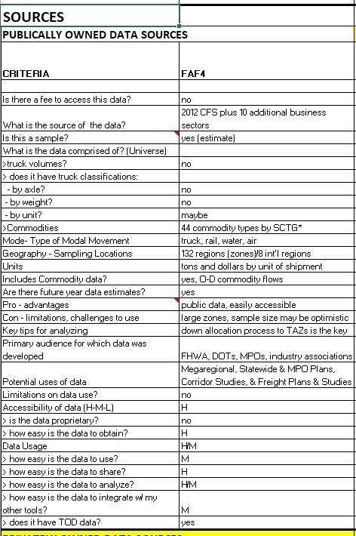
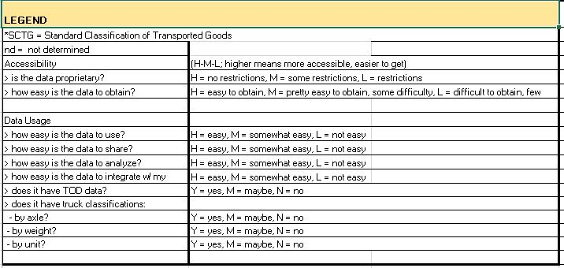
Freight Data Sources

Slide 23
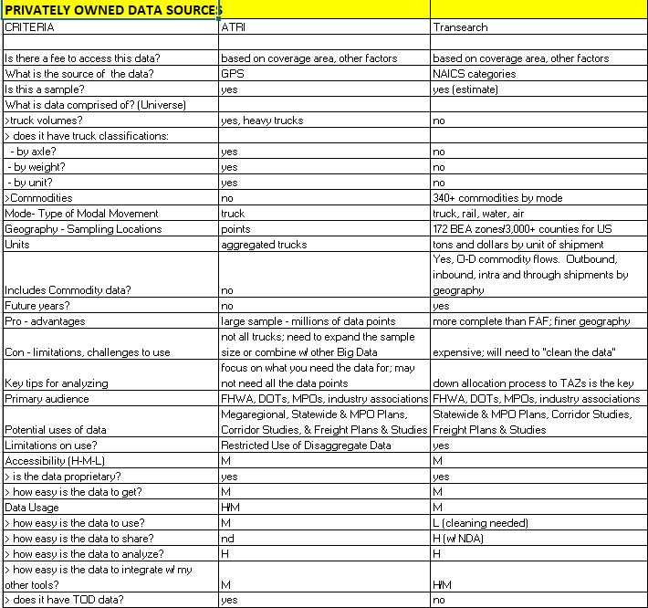
Freight Data Sources – Cont.

Slide 24
Freight Academy 2017

Slide 25
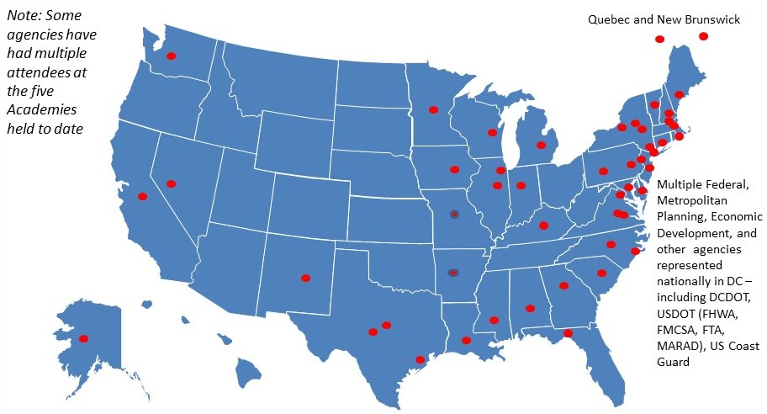
Freight Academy 2017
Held April 30 – May 5, New Brunswick, NJ
37 Total Participants
DOTs from around U.S., such as
MI, CO, IA, MN…
USDOT participants: FHWA – HQ and
Divisions such as LA, KY, D.C.;
MARAD and BTS
I-95 CC participants from MA, NY, NJ,
PA,DE, MD, VA, NC, SC, GA and FL –
State, MPO and economic
development agencies
(included 2 UMD NTC funded)
AASHTO funded two positions (staff and MO DOT)
Total 186 graduates to date

Slide 26
Freight Academy Emphasis Areas
Keynote Speakers:
Opening Session, Sunday evening:
Martin Knopp, Associate Administrator, FHWA Office of Operations
Closing Dinner, Thursday Evening
Admiral Richard Larrabee, (Ret.), Former Director Port Commerce PANYNJ
How Shippers Use the System
Retailers, Wholesalers, Agriculture Business represented
Among takeaways:
Of key importance to Shippers for performance metrics: Travel Time; Travel Time Reliability; Cost; Resiliency (natural disruptions others, i.e., labor)
Agri-business is an important freight generating sector that should not be overlooked
Free Trade Zones offer opportunity for freight economic development and can serve to become “inland ports”
Field Tour - Seafrigo

Slide 27
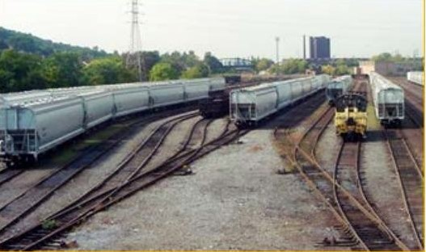
Freight Academy Emphasis Areas – Rail and Trucking
Railroads
Class 1 (BSNF) and regional (The New York, Susquehanna and Western Railway Corporation)
Among takeaways:
Both can play a key role in providing modal option, including for first and last mile access (into seaports, into “inland ports”)
Short lines/regionals should not be overlooked in planning
Trucking
NJ Motor Truck Association & ATA “Road Team” Driver
Among takeaways:
The “Top Ten” of ATRI survey clearly surfaced (i.e., bottlenecks, ELD mandate, Truck Parking…)
Truck Parking - capacity is an issue but noted the following:
Private Sector needs part of the solution for capacity
Reservation system cost may be prohibitive to drivers

Slide 28
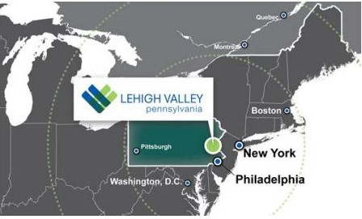
Freight Academy Emphasis Areas – Economic Development
Field Visit:
Lehigh Valley PA (revitalized Bethlehem Steel area) Growing Industrial and manufacturing, distribution and warehouse region
Among Takeaways:
Proximity to urban centers and modal connectors important to competitiveness
Linkage of public and private sector = Success
Economic Development Corporation can play a strong role in brokering parties
Land use attributes play major role in developer considerations (i.e. water, transportation links)
No specific site for truck parking, LVPC MPO is working with Freight Advisory Committee including developers, communities, industry partners on this issue

Slide 29
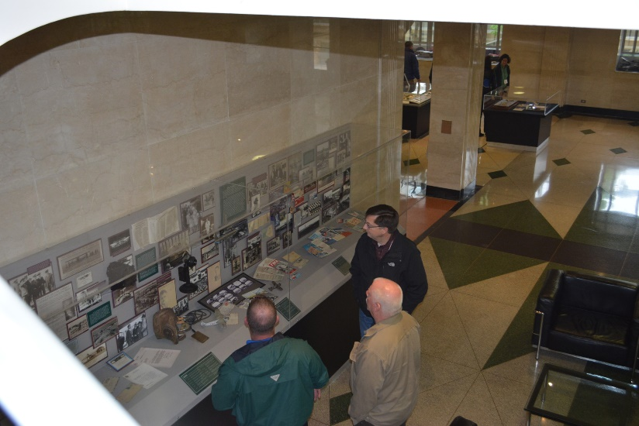
Freight Academy Emphasis Areas – cont. Port Day
Port Operations
Opening Session and tour of Port of New York & New Jersey’s Port Newark
MARAD, Port Authority Port Commerce, New York Shipping Association
Field Tours:
Foreign Auto Preparation Service (FAPS, Inc.)
Global Container Terminal, Bayonne
The Port Authority of New York & New Jersey
Among takeaways:
Ports are a key player in multi-modal freight movement
Working closely with associations and labor to improve performance
Automation continues to emerge as an important component both within terminals and at gates
Multi-modal connections can provide “last mile” and may incorporate “old with new” (port/rail to barge to urban delivery)

Slide 30
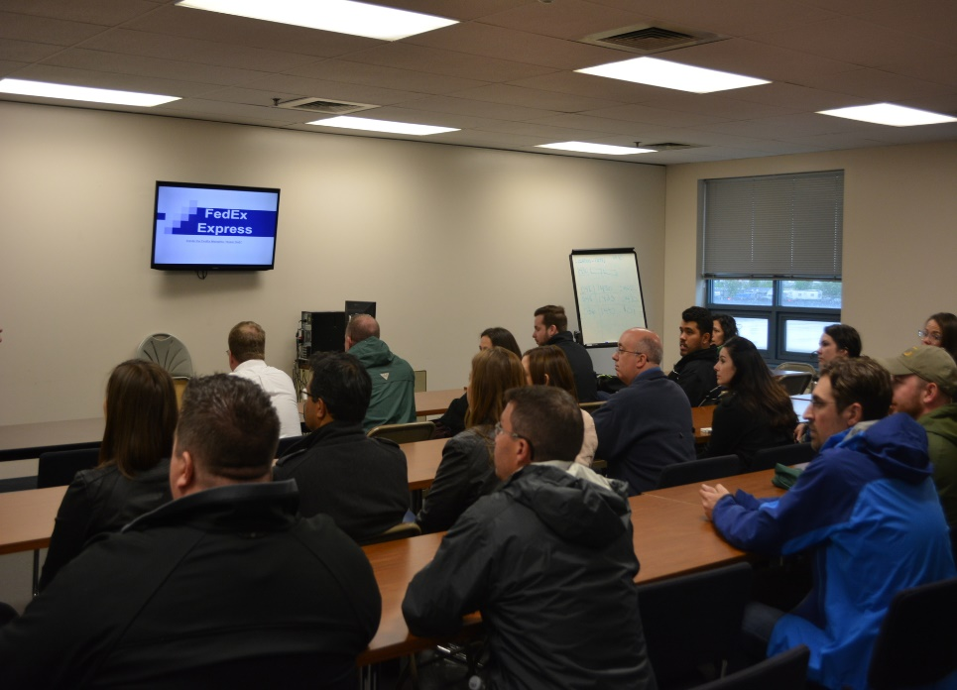
Freight Academy Emphasis Areas – cont. Air Cargo
Air Cargo Operations
Overview of Newark Liberty International Airport Air Cargo
Newark Airport, PANYNJ
Field Tour
FedEx Distribution Facility and Air
Cargo Operations
Among takeaways:
Aviation remains a key modal sector for time sensitive and/or high value cargo
Air Cargo can be a good barometer to changing trends and cycles in supply chains

Slide 31
Freight Academy: Moving Forward
Capstone Projects (now thru Fall 2017)
Economic Development
Truck Parking
Innovations in Transportation
Ports
2019 Freight Academy
Encourage agencies to set aside capacity development funding
Promote scholarship support (e.g., I95CC, AASHTO, NTC, FHWA, others!)
“In one completely packed week, the Freight Academy exposed me to facets of the freight system I hadn't previously considered and allowed a firsthand look at other aspects I had only been able to read about. The speakers were extremely knowledgeable and each site visit was eye opening.”
Gabriel Sherman Freight Plan Coordinator/MPO Liaison
MassDOT

Slide 32
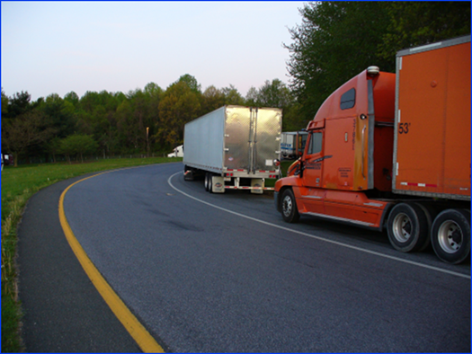
I-95 Coalition Real Time Truck Parking Availability Project
Project funded by FHWA to demonstrate proof-of-concept and deploy real time information system to:
Accurately identify available parking spaces.
Communicate truck parking information to truck drivers in a safe, timely useful, and efficient fashion

Slide 33
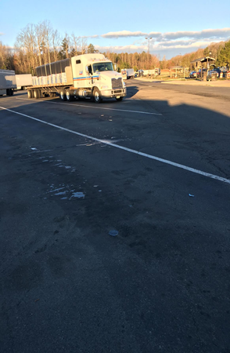
I-95 Truck Parking Project
Data Collection system (in pavement sensors) deployed and integrated with host system, and extensively tested at two Tier I Test locations starting in November 2015:
I-95 Ladysmith Rest Area, Northbound, Caroline County, VA.
I-95 Welcome Center, Northbound, Laurel, MD.
Accuracy rates 95%+
Final deployment sites were selected based on plans for VDOT to continue operation.
Installations at:
I-95 Sites at Ladysmith NB, Carson NB completed
I-64 New Kent (EB) completed
I-95 Dale City NB (in process, July 2017completion)
Possible 5th sites in VA TBD
Project to be completed by end of 2017

Slide 34
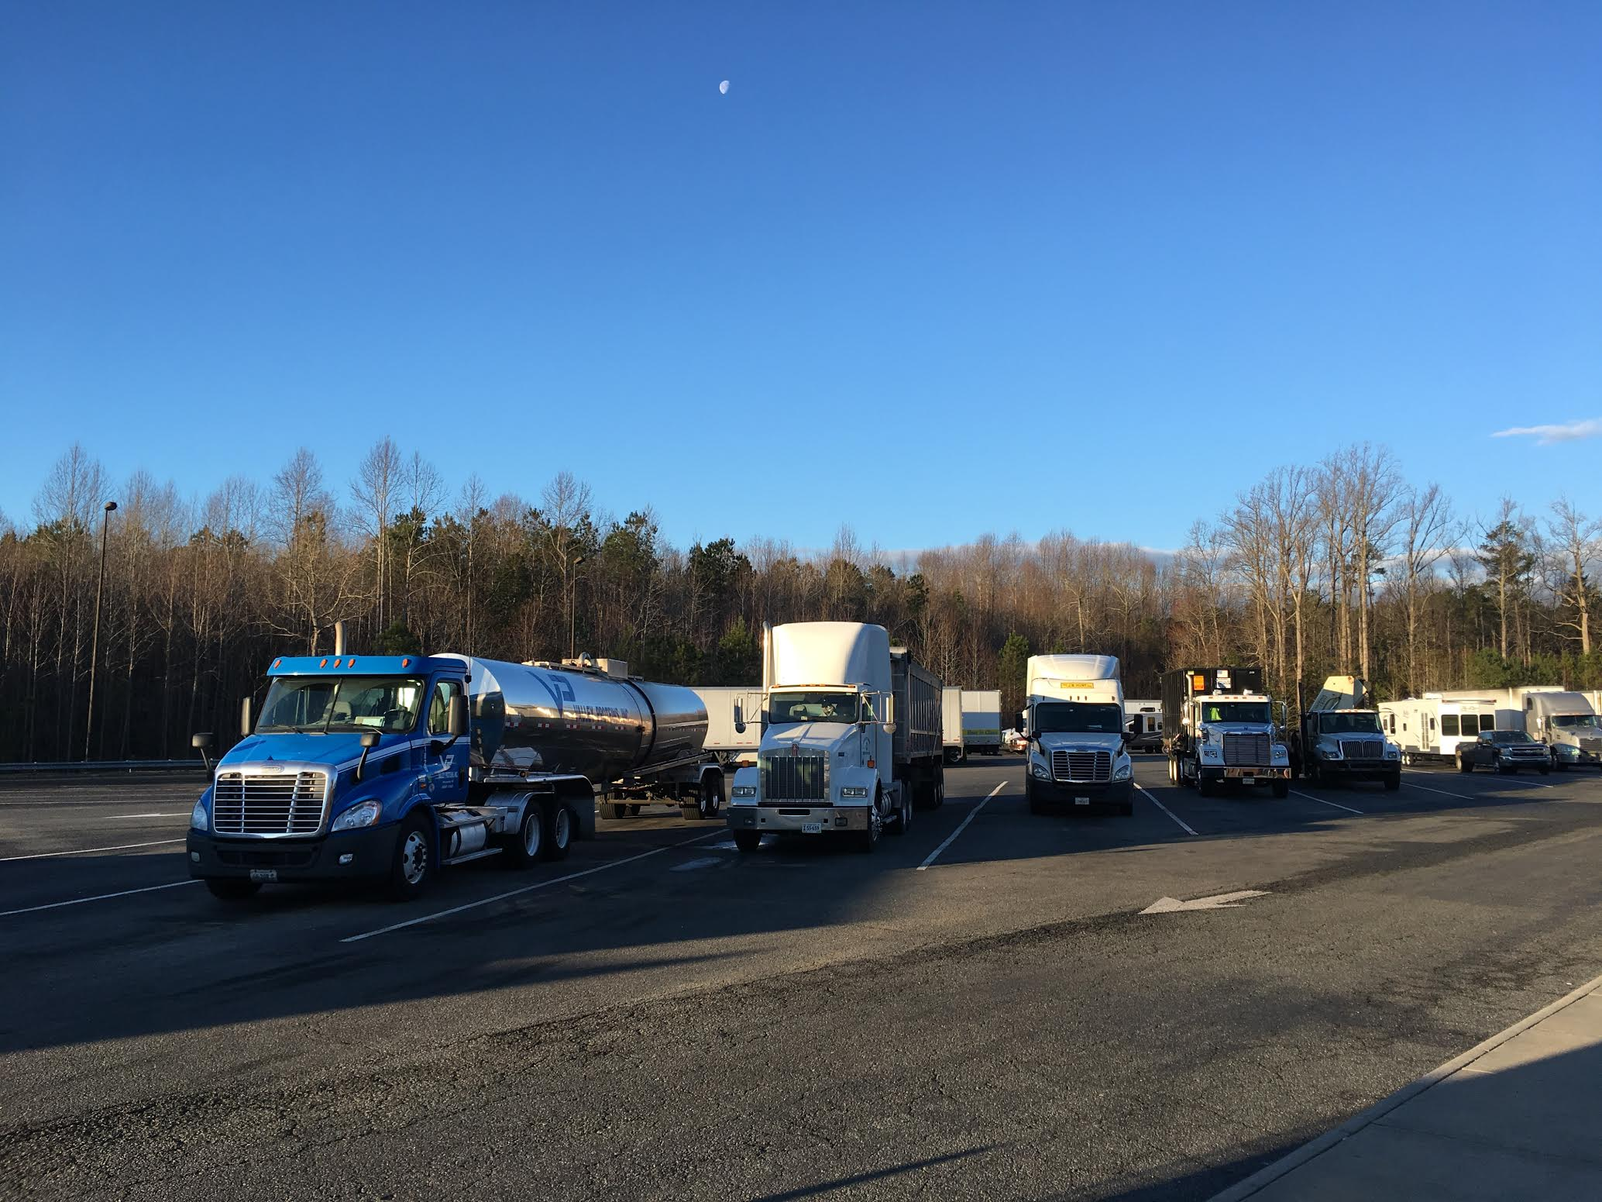
I-95 Truck Parking Project
Data can be successfully collected, integrated and disseminated, including via “hands free smart phone/IVR technology” to drivers
Strong interest in having data available to third party app developers
For public agency ATMS integration must factor in considerations for different technology components (i.e., sensors)
Public agency role critical for sites on public ROW
Agency role in coordination of sites
and integration of information
Agency recognition of on-going
O&M costs is important
Data can have value to agency

Slide 35
Spotlight Presentation: “Philly Freight Finder”
Michael Ruane
Transportation Planner
Delaware Valley Regional Planning Commission

Slide 36
2017/2018 Committee Focus Areas: Truck Parking Symposium
Coalition Peer Exchange/Information Forum to:
Share key insights from the I-95 Coalition truck parking project and best practices from other truck parking projects including lessons learned from:
Experiences with procurement, site selection considerations, program costs (including deployment and continued O&M), data ownership, etc.
Examine emerging issues and innovative strategies to address truck parking issues
Truck parking information systems, 3rd party Apps , capacity expansion approaches, implications of potential changes in regulations for commercial activity at rest areas, public private partnerships…
Timeframe: 2017-2018 Program Year

Slide 37
2017/2018 Committee Focus Areas:
Committee Webinars
Hold a series of information exchange/innovative practice sharing webinars on topic such as:
“Roundtable presentations” from agencies on their innovative use of freight data/in-house analytical tools
Advancing freight data “state of practice”
Exploring ways to improve freight data quality, access, cost
i.e. through shared procurement, investigating alternative sources
Emerging technologies and implications for Corridor states
i.e. automated/Connected trucks; truck platooning, implications of Electronic Log Device mandate…
Support “water cooler” corridor/regional discussions as needed

Slide 38
Polling
What is your interest in a series of webinars showcasing states’ in-house freight tools and sharing best practices on how they are using them for freight planning:
(choose from high, medium, low)
What is your interest in hearing how agencies can apply Transportation Systems Management and Operations to enhance truck mobility on their system?
(choose from high, medium, low)
What importance to you place on having dialogue on the implications of integration of connected/automated trucks (including truck platooning) into the Eastern Seaboard.
(Choose from high, medium, low)
Which of the following topics related to data would you be most interested in:
a) Innovative use of data for freight analysis – best practices/lessons learned
b) Examining "non-conventional" data sources and how might they be used in freight planning

Slide 39
Poll 1
What is your interest in a series of webinars showcasing states' in-house freight tools and best practices on how they use them for freight planning?

Slide 40
Poll 2
What is your interest in hearing how agencies can apply Transportation System Management and Operations to enhance truck mobility on their system?

Slide 41
Poll 3
What importance do you place on having dialog on the implications of integrated connected/automated trucks (including platooning) into the Eastern Seabord?

Slide 42
Poll 4
Which of the following data-related topics would you be most interested in:
Innovative use of data for freight analysis – best practices/lessons learned
Examining “Non-Conventional” data sources and how they might be used in freight planning

Slide 43
Thank You For Joining Today!
For Additional Information, please contact:
Marygrace Parker
Director, Freight and Innovation in Transportation
I-95 Corridor Coalition
518-852-4083
mgparker@i95coalition.org

